Slide 1
Cloud Service Delivery Model
Lecture 2

Slide 2
Introduction
In a nutshell, the existing Internet provides to us content in the forms of videos, emails and information served up in web pages.
With Cloud Computing, the next generation of Internet will allow us to “buy” IT services from a web portal, drastic expanding the types of merchandise available beyond those on e-commerce sites such as eBay and Taobao.

Slide 3
Continue…
We would be able to rent from a virtual storefront the basic necessities to build a virtual data center: such as CPU, memory, storage, and add on top of that the middleware necessary: web application servers, databases, enterprise server bus, etc. as the platform(s) to support the applications we would like to either rent from an Independent Software Vendor (ISV) or develop ourselves.
Together this is what we call as “IT as a Service,” or ITaaS, bundled to us the end users as a virtual data center.

Slide 4
Continue…
Within ITaaS, there are three layers starting with Infrastructure as a Service, or IaaS, comprised of the physical assets we can see and touch: servers, storage, and networking switches.
At the IaaS level, what cloud computing service provider can offer is basic computing and storage capability, such as the cloud computing center founded by IBM in Wuxi Software Park and Amazon EC2.
Taking computing power provision as an example, the basic unit provided is the server, including CPU, memory, storage, operating system and system monitoring software.

Slide 5
Continue…
At the PaaS level, what the service providers offer is packaged IT capability, or some logical resources, such as databases, file systems, and application operating environment.
Currently, actual cases in the industry include Rational Developer Cloud of IBM, Azure of Microsoft and AppEngine of Google. At this level, core technologies are involved.
The first core technology is software development, testing and running based on cloud.

Slide 6
Continue…
PaaS service is software developer-oriented. It used to be a huge difficulty for developers to write programs via network in a distributed computing environment, and now due to the improvement of network bandwidth, two technologies can solve this problem: the first is online development tools.
Developers can directly complete remote development and application through browser and remote console (development tools run in the console) technologies without local installation of development tools

Slide 7
Continue…
Another is integration technology of local development tools and cloud computing, which means to deploy the developed application directly into cloud computing environment through local development tools.
The second core technology is large-scale distributed application operating environment. It refers to scalable application middleware, database and file system built with a large amount of servers.
This application operating environment enables application to make full use of plentiful computing and storage resource in cloud computing center to achieve full extension, go beyond the resource limitation of single physical hardware, and meet the access requirements of millions of Internet users.

Slide 8
Continue…
The top of the ITaaS is what most non-IT users will see and consume: Software as a Service (SaaS).
At the SaaS level, service providers offer consumer or industrial applications directly to individual users and enterprise users.
At this level, the following technologies are involved: Web 2.0, Mashup, SOA and multi-tenancy.

Slide 9
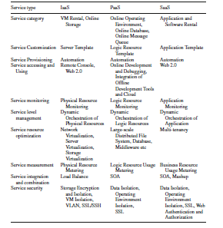

Slide 10
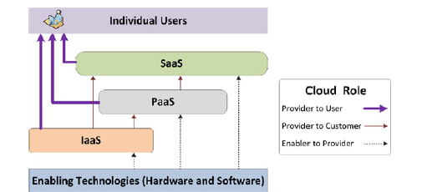
Continue…

Slide 11
Services in Cloud[Service Delivery Model]
Based on how it works, cloud computing services can be classified into:
Software as a service (SaaS):
The registered software applications are managed by the provider.
Browser based access allows individual applications to be used by the customers without bothering about licensing or server expenses.
In essence, SaaS is simply the cloud vendor providing the given piece of software you want to use, on their servers.
That is, unlike PaaS in which you developed your own application, SaaS provides the application for you.

Slide 12
Continue…
The line between SaaS and PaaS gets a little blurry, but the delineation is whether the provider supplies the application (SaaS) or simply provides a mechanism to develop your own applications (PaaS).

Slide 13
Some more on SaaS
SaaS (Software-as-a-Service) is a software model that incorporates the delivery of a software application to a remote client via the Internet.
Software-as-a-Service relies on the centralized hosting of a software application in the “cloud” which is typically accessed via a web browser application.
Software-as-a-Service can be configured to allow public access or private access, where only users with the proper credentials are granted access to a particular hosted software application.
Software-as-a-Service, also known as on-demand software, provides many advantages over the traditional software model.

Slide 14
Continue…
Platform as a service (PaaS):
The working platforms are managed by the provider to run and develop business applications.
It is built so as to support all stages of creating a web application online, without additional software needed in local computers.
Platform as a Service (PaaS) is a way to build applications and have them hosted by the cloud provider.
It allows you to deploy applications without having to spend the money to buy the servers on which to house them.

Slide 15
Some more on PaaS…
PaaS is a method by which an entire computing platform can be utilized remotely over the internet via cloud computing.
PaaS provides a way to essentially outsource all of the infrastructure needed to execute a solution without the need to purchase and implement a new platform.
PaaS typically allow users to develop, test and deploy applications in a single environment.

Slide 16
Continue…
Infrastructure as a service (IaaS):
It can be considered as an enhanced version of web hosting.
Virtual servers along with related data and equipment can be purchased on a per-use basis.
In this scenario, we are using the cloud provider’s machines.
Another term for this type of computing is Everything as a Service i.e. you are using a virtualized server and running software on it.
One of the most prevalent is Amazon Elastic Compute Cloud (EC2) and another player in the field is GoGrid.

Slide 17
Continue…
Amazon EC2’s simple web service interface allows businesses to obtain and configure capacity with minimal friction.
Amazon EC2 changes the economics of computing by allowing you to pay only for capacity that you actually use.
GoGrid is a service provider of Windows and Linux cloud-based server hosting, and offers 32-bit and 64-bit editions of Windows Server 2008 within its cloud computing infrastructure.
GoGrid becomes one of the first Infrastructure as a Service (IaaS) providers to offer Windows Server 2008 “in the cloud.”

Slide 18
Some More on IaaS
IaaS (infrastructure as a service) refers to the delivery of computing capacity and infrastructure as a service.
It is also known as HaaS (hardware as a service), IaaS encompasses all of the physical computing resources that support delivery of applications as a service.
IaaS can be delivered via a public cloud, a private cloud, a community cloud or a hybrid cloud.
The infrastructure that is delivered by IaaS resides on the bottom layer of a cloud computing stack; with PaaS delivery occurring on the middle layer and SaaS delivery occurring on the top layer.
In many cases, IaaS is bundled together with PaaS and SaaS delivery – as a complete cloud computing solution, as is the case with the hosted cloud services delivered by providers

Slide 19
Let’s discuss on Cloud Stack!!!

Slide 20
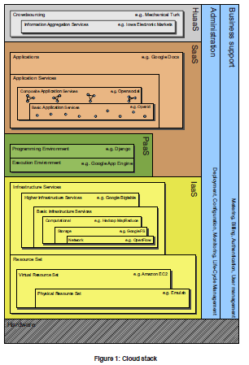

Slide 21
Infrastructure as a Service (IaaS)
On the lowest level of the infrastructure closest to the hardware there are two types of services,
Physical Resource Set (PRS) and Virtual Resource Set (VRS) services.
Both of these service types provide a management front-end API for a set or pool of resources in order to allow higher level services to automate setup and tear-down, demand based scalability, fail-over and operating system hosting.
Primary functionality includes starting and stopping individual resources, OS imaging, network topology setup and capacity configuration.

Slide 22
Continue…
The PRS(Physical Resource Set) layer implementation is hardware dependent and therefore tied to a hardware vendor, whereas the VRS(Virtual Resource Set) layer can be built on vendor independent hypervisor technology such as Xen or on top of a PRS service to run in multi-vendor Clouds such as the Open Cirrus test bed.
Examples of PRS services are as follows: Emulab and iLO .
VRS services are as follows Amazon EC2 , Eucalyptus , Tycoon , Nimbus, and OpenNebula.

Slide 23
Continue…
One level higher up in the stack but still in the IaaS category there are three types of Basic Infrastructure Services (BIS), computational, storage, and network.
Some examples are MapReduce (computational), GoogleFS (storage), and OpenFlow (network).
As the highest level in the IaaS stack we can see Higher Infrastructure Services (HIS).
Amazon’s Dynamo , and Google’s Bigtable all fall into this category as they are typically built on top of BIS tools.

Slide 24
Platform as a Service (PaaS)
Moving up to the PaaS level of our integrated stack it categorizes the services into Programming Environments and Execution Environments.
Example of the former is Sun’s project Caroline and the Django framework , and examples of the latter are Google’s App Engine , Joyent’s Reasonably Smart and Microsoft’s Azure .

Slide 25
Continue…
As seen by these examples an Execution Environment PaaS typically also encompasses a Programming Environment PaaS.
We could potentially replace the Django framework in Google App Engine with our own Programming Environment and Microsoft Azure offers a wide range of alternative programming tools under the Azure runtime umbrella.
This decoupling between execution and development environments is thus represented by having two categories in stack model.

Slide 26
Software as a Service(SaaS)
All the applications that run on the Cloud and provide a direct service to the customer are located in the SaaS layer.
The application developers can either use the PaaS layer to develop and run their applications or directly use the IaaS infrastructure.
Here it distinguishes between Basic Application Services and Composite Application Services.
Examples of Basic Application Services are the OpenId and Google Maps services.

Slide 27
Continue…
In the Composite Application Service category we have the mash-up support systems with Opensocial as the prominent example allowing entire social networks like MySpace to be used as Basic Services.
It categorizes Basic and Composite services into Application Services, which comprise the highest level building blocks for end-user applications running in the Cloud, such as Google Docs , Microsoft’s Office Live and OpenSocial mash-ups such as Auciti’s Hangout.

Slide 28
Human as a Service (HaaS)
Some services rely on massive-scale aggregation and extraction of information from crowds of people.
Each individual in the crowd may use whatever technology or tools he or she see fit to solve the task.
The top-most layer in the stack is known as Human as a Service (HuaaS).

